Slide 1

Customer Shopping Behavior Analysis
This project analyzes 3,900 customer purchases to uncover spending patterns, segments, product preferences, and subscription behavior. Our goal is to guide strategic business decisions.

Slide 2



Dataset Summary: Key Features
Customer Demographics
Purchase Details
Shopping Behavior
Age, Gender, Location, Subscription Status
Item, Category, Amount, Season, Size, Color
Discount, Promo Code, Previous Purchases, Frequency, Review Rating, Shipping Type
The dataset comprises 3,900 rows and 18 columns, with 37 missing values in the Review Rating column.

Slide 3

Exploratory Data Analysis (Python)
Data Preparation & Cleaning
Data Loading: Imported dataset using pandas.
Initial Exploration: Checked structure and summary statistics.
Missing Data Handling: Imputed missing Review Ratings using median.

Slide 4



Feature Engineering & Database Integration
Age Group Column
Purchase Frequency
MySQL Integration
Binned customer ages for segmentation.
Derived from purchase data.
Loaded cleaned data for SQL analysis.
We also verified and dropped redundant columns like 'promo_code_used' for data consistency.

Slide 5
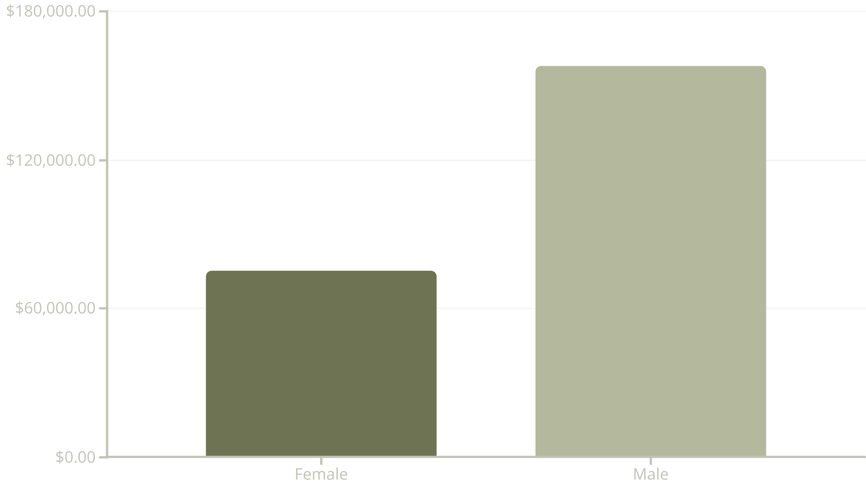
Revenue by Gender
Male customers generated significantly more revenue than female customers, indicating a potential area for targeted marketing strategies towards female demographics.

Slide 6


Top Products & Shipping Insights
Top 5 Products by Rating
Shipping Type Comparison
Gloves: 3.86
Average purchase amounts:
Sandals: 3.84
Standard Shipping: $58.46
Boots: 3.82
Express Shipping: $60.48
Hat: 3.80
Skirt: 3.78

Slide 7


Subscription & Discount Analysis
Subscribers vs. Non-Subscribers
Discount-Dependent Products
Subscribers (1053) have a slightly lower average spend ($59.49) than non-subscribers (2847) ($59.87), but contribute significantly to total revenue.
Top 5 products with highest percentage of discounted purchases: Hat (50%), Sneakers (49.66%), Coat (49.07%), Sweater (48.17%), Pants (47.37%).
This highlights the impact of discounts on specific product sales and subscriber engagement.

Slide 8



Customer Segmentation & Loyalty
New
1
83 Customers
Returning
2
701 Customers
Loyal
3
3116 Customers
The majority of our customer base falls into the 'Loyal' segment, indicating strong retention. Repeat buyers (those with >5 purchases) are more likely to subscribe (958 subscribers vs. 2518 non-subscribers).

Slide 9
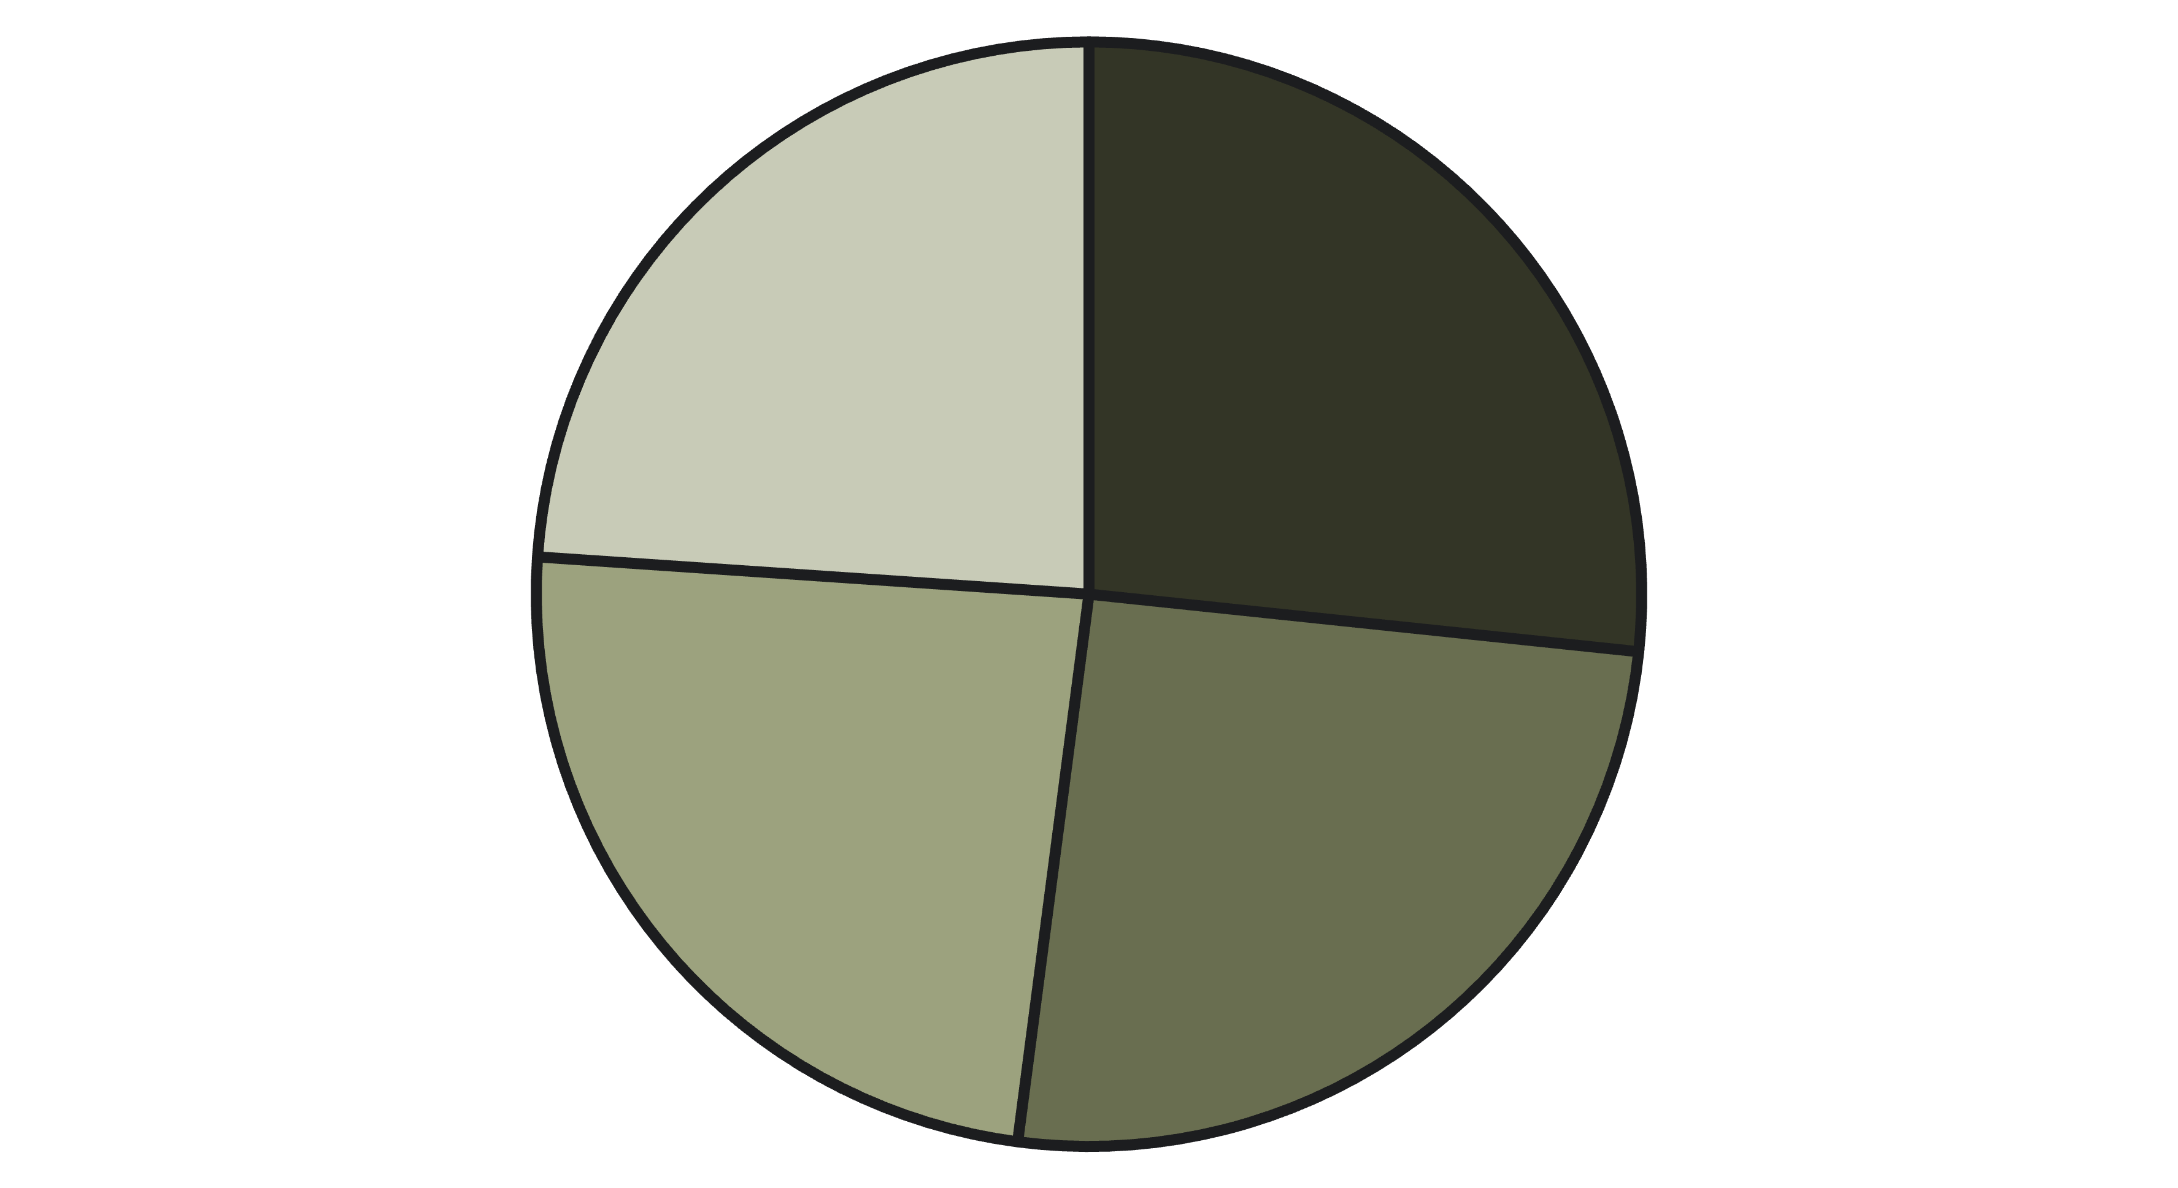
Revenue by Age Group
Young Adult
Middle-aged
Adult
Senior
Young Adults contribute the highest revenue, followed closely by Middle-aged customers. This insight can inform targeted marketing campaigns.

Slide 10

Business Recommendations
Boost Subscriptions
Customer Loyalty Programs
Promote exclusive benefits to increase subscriber base.
Reward repeat buyers to foster loyalty and retention.
Targeted Marketing
Product Positioning
Focus efforts on high-revenue age groups and express-shipping users.
Highlight top-rated and best-selling products in campaigns.

